Slide 1
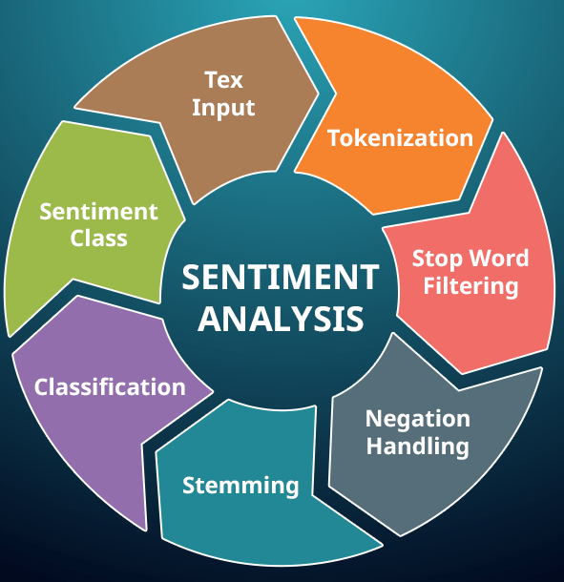
Sentiment Analysis for Ecommerce
VIGNESH M

Slide 2
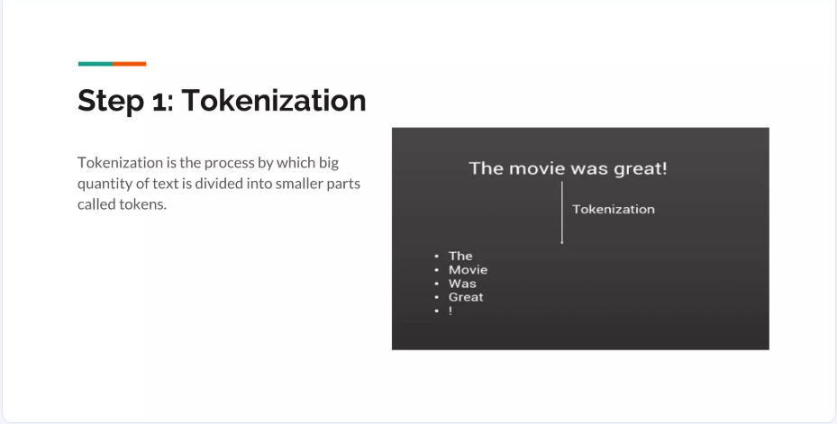

Slide 3
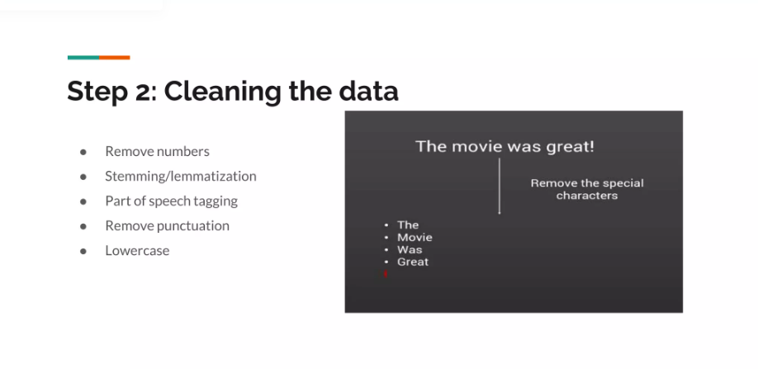

Slide 4
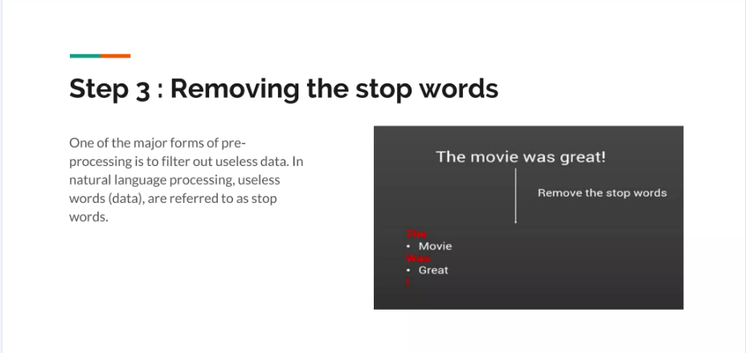

Slide 5
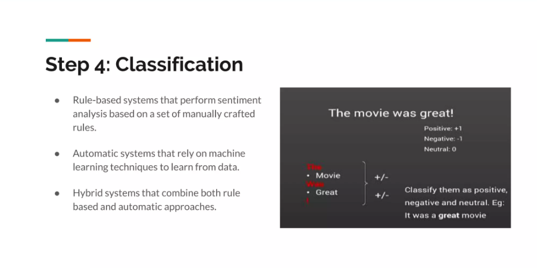

Slide 6
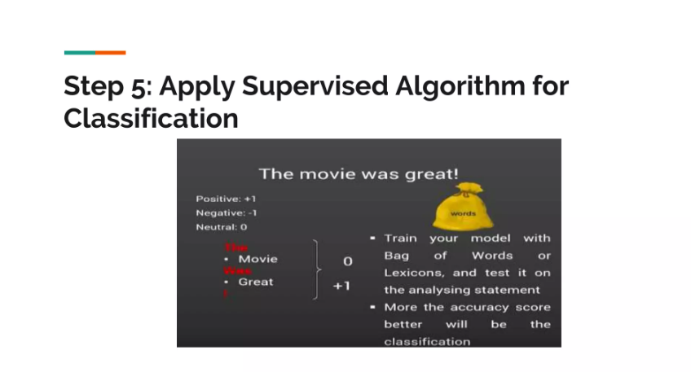

Slide 7
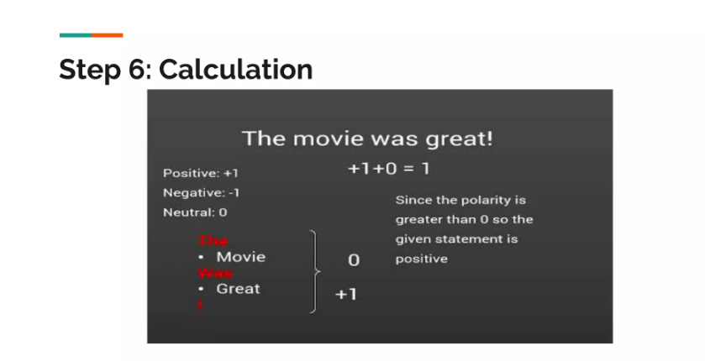

Slide 8
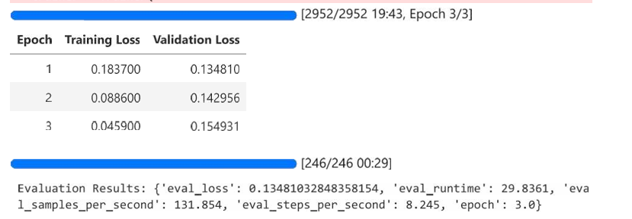
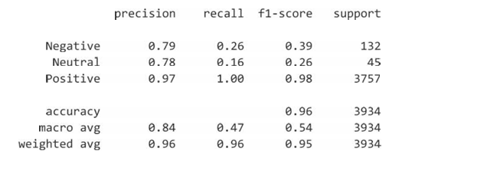
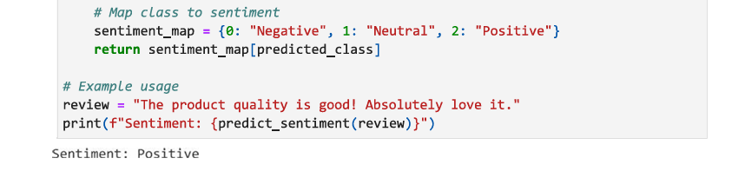
Bert Model Training
Evaluation Metrics
Sample output

Slide 9
Git Hub link :
https://github.com/Vignesh160201/Data-Science/tree/689361e7e8be2fb3d2b3a0102aca95570e898e17/Natural%20Language%20Processing%20-%20NLP
Thank you

